Slide 1

CE101 Engineering Drawing Lec7: Section of Solids
Indian Institute of Technology Guwahati
Notes:
Today we will discuss about the Modeling and

Slide 2
Sectional Views
Sectional view
Obtained by taking the section of the object along a particular plane
An imaginary cutting plane is used to obtain the section of the object.
Presence of several hidden lines in an object creates a complicated and confusing visualization
Therefore, the general practice
Draw sectional views for complex objects in addition to simple orthographic views.

Slide 3
Projection of Solids. A square pyramid, 40 mm base sides and axis 60 mm long, has a triangular face on the ground and the TV makes an angle of 45⁰ with the VP. Draw its projections. Take apex nearer to VP
Solution Steps :
Triangular face on Hp , means it is lying on Hp:
1.Assume it standing on Hp.
2.It’s Tv will show True Shape of base( square)
3.Draw square of 40mm sides with one side vertical Tv &
taking 50 mm axis project Fv. ( a triangle)
4.Name all points as shown in illustration.
5.Draw 2nd Fv in lying position I.e.o’c’d’ face on xy. And project it’s Tv.
6.Make visible lines dark and hidden dotted, as per the procedure.
7.Then construct remaining inclination with Vp
( Vp containing axis ic the center line of 2nd Tv.Make it 45⁰ to xy as
shown take apex near to xy, as it is nearer to Vp) & project final Fv.
o’
a’₁
b’₁
o’
a’
Y
X
b’
c’
d’
d’₁
c’₁
o’₁
d₁
a
d
d₁
a’
a₁
a₁
b’
c’
d’
d₁
o₁
a₁
o
o₁
c₁
b₁
o₁
b
c
c₁
b₁
(APEX
NEARER
TO V.P).
c₁
b₁
(APEX
AWAY
FROM V.P.)
For dark and dotted lines
1.Draw proper outline of new view DARK. 2. Decide direction of an observer.
3. Select nearest point to observer and draw all lines starting from it-dark.
4. Select farthest point to observer and draw all lines (remaining)from it- dotted.

Slide 4
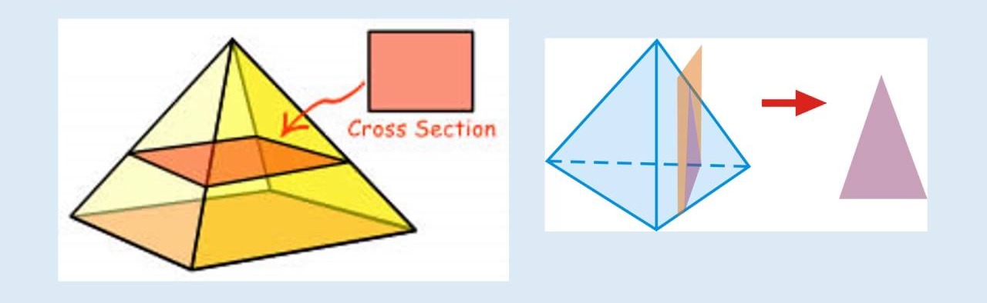
Theory of Sectioning
Whenever a section plane cuts a solid, it intersects (and or coincides with) the edges of the solids.
The points at which the section plane intersects an edge of the solid is called the points of intersection (POIs).
POIs are located in one view and then projected in the desired view to draw the section.
In case of the solids having a curved surface, viz., cylinder, cone and sphere, POIs are located between the cutting plane and the lateral lines.

Slide 5
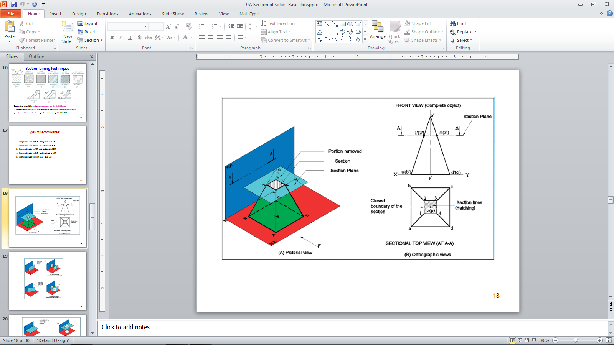
Cutting Plane and their Representation
A cutting plane is represented by a cutting plane line or section plane line
The cutting plane line indicates the line view of the cutting plane.
The two ends of the cutting plane line are made slightly thicker and provided with arrows.
The direction of the arrow indicates the direction of viewing of the object.
OBSERVER
ASSUME
UPPER PART
REMOVED
SECTON PLANE
IN FV.

Slide 6
SECTIONING A SOLID
An object ( here a solid ) is cut by
some imaginary cutting plane
to understand internal details of that object.
The action of cutting is called
SECTIONING a solid
&
The plane of cutting is called
SECTION PLANE.
Two cutting actions/section planes are recommended.
A) Section Plane perpendicular to VP and inclined to HP.
(Auxiliary Inclined Plane i.e. AIP)
NOTE:- This section plane appears
as a straight line in FV.
B) Section Plane perpendicular to HP and inclined to VP.
(Auxiliary Vertical Plane i.e. AVP)
NOTE:- This section plane appears
as a straight line in TV.
Remember:-
1. After launching a section plane
(either in FV or TV), the part towards observer
is assumed to be removed.
2. As far as possible, the smaller part is
assumed to be removed.
OBSERVER
ASSUME
UPPER PART
REMOVED
SECTON PLANE
IN FV.
(A)
(B)
ASSUME
LOWER PART
REMOVED
SECTON PLANE
IN TV.
OBSERVER

Slide 7
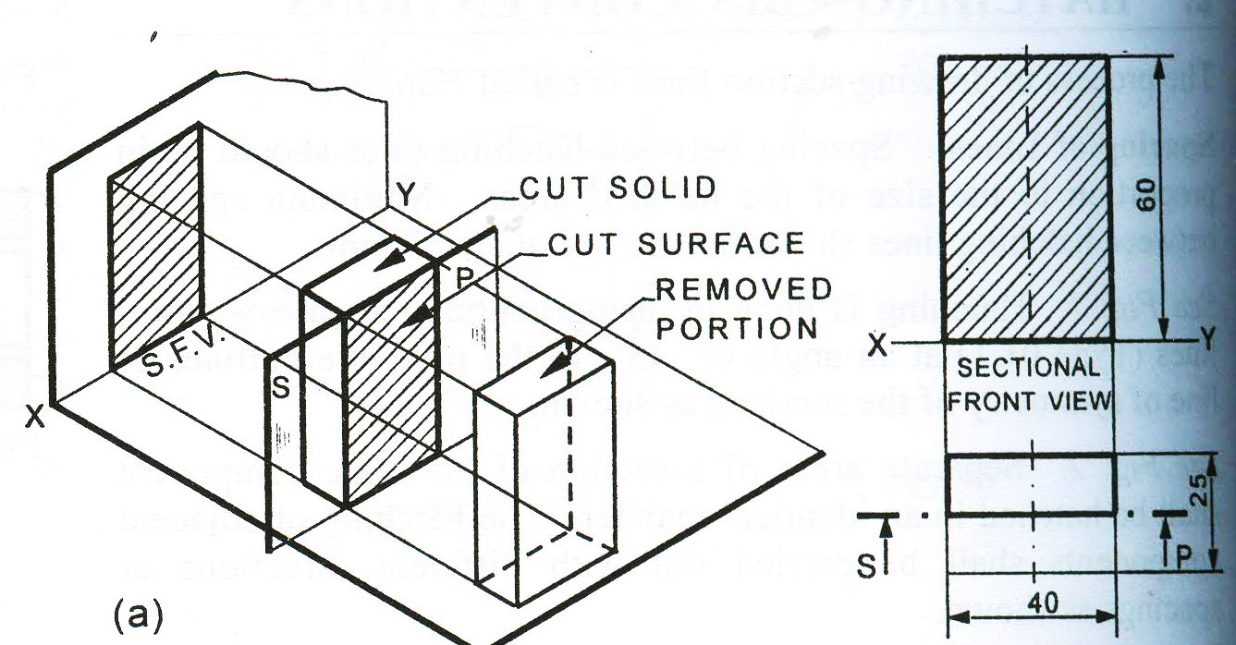
Remember:-
After launching a section plane either in FV or TV, the part towards observer is assumed to be removed.
As far as possible the smaller part is assumed to be removed.

Slide 8
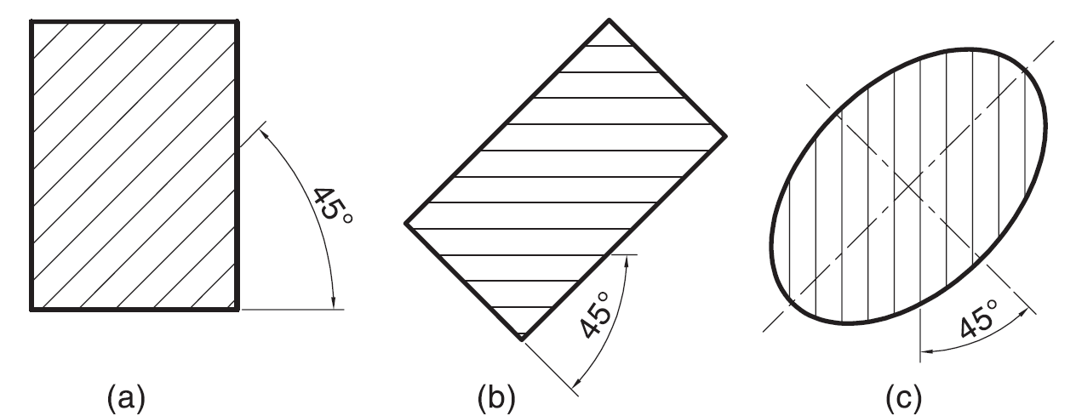
Hatching of the Sections
The surface created by cutting the object by a section plane is called as section. The section is indicated by drawing the hatching lines (section lines) within the sectioned area. The hatching lines are drawn at 45° to the principal outlines or the lines of symmetry of the section. The spacing between hatching lines should be uniform and in proportion to the size of the section.
2H
HB

Slide 9
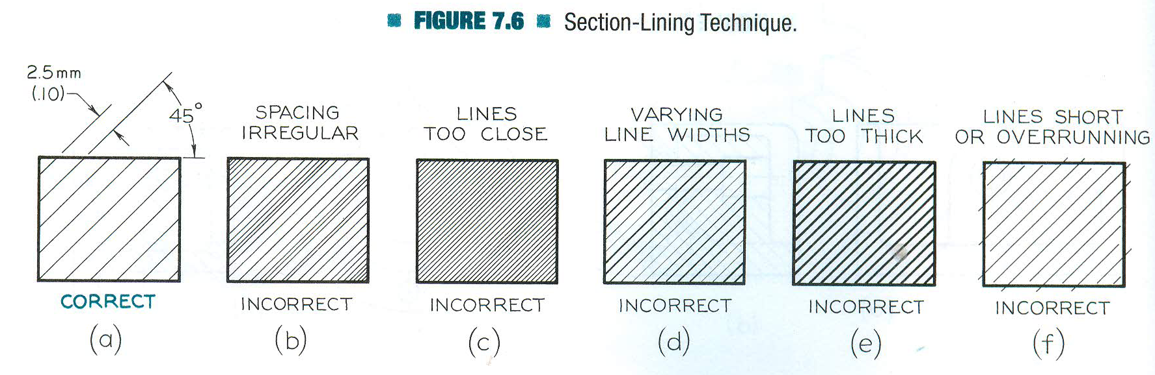
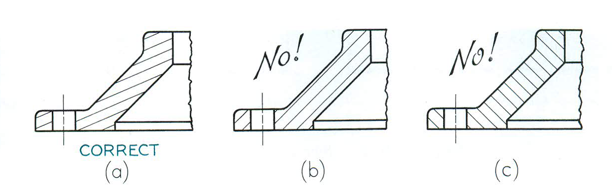
Section Lining Techniques
Section lines should be uniform thin, never varying in thickness
If sections lines drawn at 45° with horizontal are parallel or perpendicular to a prominent visible outline, the angle should be changed to 30° /60°
Section lines should intersect prominent boundaries

Slide 10
True Shape of Sections
A section will show its true shape when viewed in the direction normal to the section plane.
To find the true shape of a section, it must be projected on a plane parallel to the section plane.
True shape of section
Horizontal section plane -> TV
Vertical section plane -> FV
Profile section plane -> SV
AIP -> Auxiliary TV
AVP -> Auxiliary FV

Slide 11
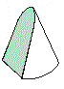
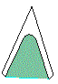
Typical Section Planes
&
Typical Shapes
Of
Sections.
Triangle
Section Plane
Through Generators
Ellipse
Section Plane
Through Apex
Parabola
Section Plane Parallel
to end generator.
Section Plane
Parallel to Axis.
Hyperbola
Ellipse
Trapezium
Cylinder through
generators.
Sq. Pyramid through
all slant edges
Notes:
IMP slide- remember the shapes

Slide 12
True Shape of Sections
True shape
Polyhedra – Polygon and sides equal to POIs
Solid | Position of the Cutting Plane | True Shape of Section
Cylinder | Perpendicular to axis Inclined to the axis cutting all generators Parallel to the axis | Circle Ellipse Rectangle
Cone | Perpendicular to axis Inclined to the axis cutting all generators Parallel to a generator Inclined to and on one side of the axis Parallel to the axis Passing through the axis or the apex | Circle Ellipse Parabola Hyperbola Rectangular Hyperbola Triangle
Sphere |  | Circle
Pyramids and Prisms |  | Straight line segmented curves

Slide 13
ILLUSTRATION SHOWING
IMPORTANT TERMS
IN SECTIONING.
For TV
For True Shape
SECTION
PLANE
TRUE SHAPE
Of SECTION
x
y
Apparent Shape
of section
SECTION LINES
(45⁰ to XY)
SECTIONAL T.V.

Slide 14
Types of section Planes
Perpendicular to H.P. and parallel to V.P.
True shape in FV
Perpendicular to V.P. and parallel to H.P.
True shape in TV
Perpendicular to V.P. and inclined to H.P.
True shape in Auxiliary view
Perpendicular to H.P. and inclined to V.P.
True shape in Auxiliary view
Perpendicular to both H.P. and V.P.
True shape in Profile view

Slide 15
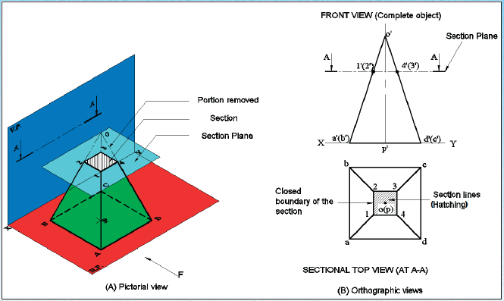

Slide 16
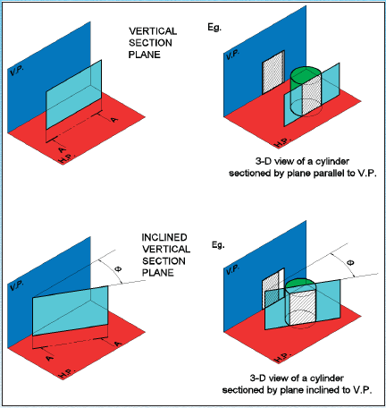

Slide 17
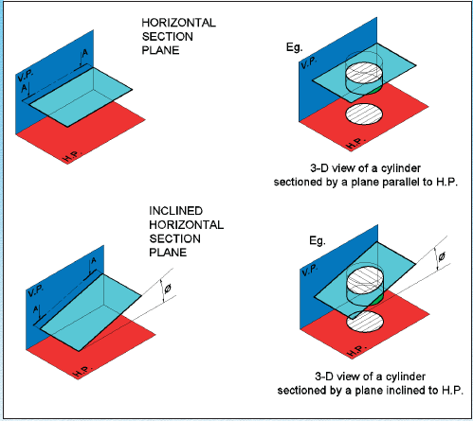

Slide 18
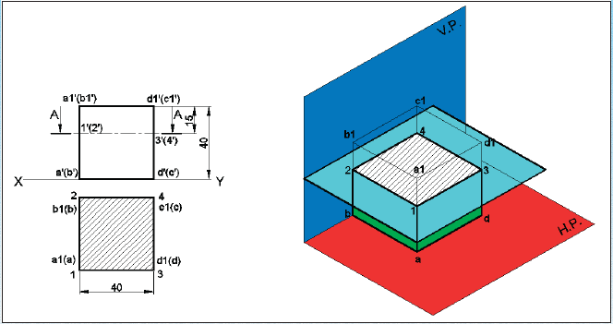
SECTIONAL VIEW – PARALLEL TO HP AND PERPENDICULAR TO VP
A cube of 40 mm side is cut by a horizontal section plane, parallel to HP at a distance of 15 mm from the top end. Draw the sectional top view and front view

Slide 19
Perpendicular to H.P. and Parallel to V.P.
A rectangular prism, side of base 40 mm x 25 mm and height 60 mm, rest with its base on H.P. such that one of its larger rectangular faces is parallel to V.P. A section plane perpendicular to H.P. and parallel to V.P. cuts the prism into two equal halves. Draw its top view and sectional front view.

Slide 20
Perpendicular to H.P. and Parallel to V.P.
A hexagonal prism, side of base 30 mm and axis 60 mm, rest with its base on H.P. such that one of its rectangular faces is parallel to V.P. A section plane perpendicular to H.P. and parallel to V.P. cuts the prism a distance of 10 mm from its axis. Draw its top view and sectional front view.

Slide 21
Perpendicular to V.P. and Parallel to H.P.
A pentagonal pyramid, side of base 30 mm and axis 60 mm, rest with its base on H.P. and one of the edges of its base is perpendicular to V.P. It is cut by section plane perpendicular to V.P. and parallel to H.P. and passing through the axis at a point 35 mm above the base. Draw its top view and sectional front view.
Notes:
Now as the section plane intersects the pentagonal pyramid at the slant edges, we take the projections of the POI’s obtained in the FV , and take their intersections with the slant edges in the TV.

Slide 22
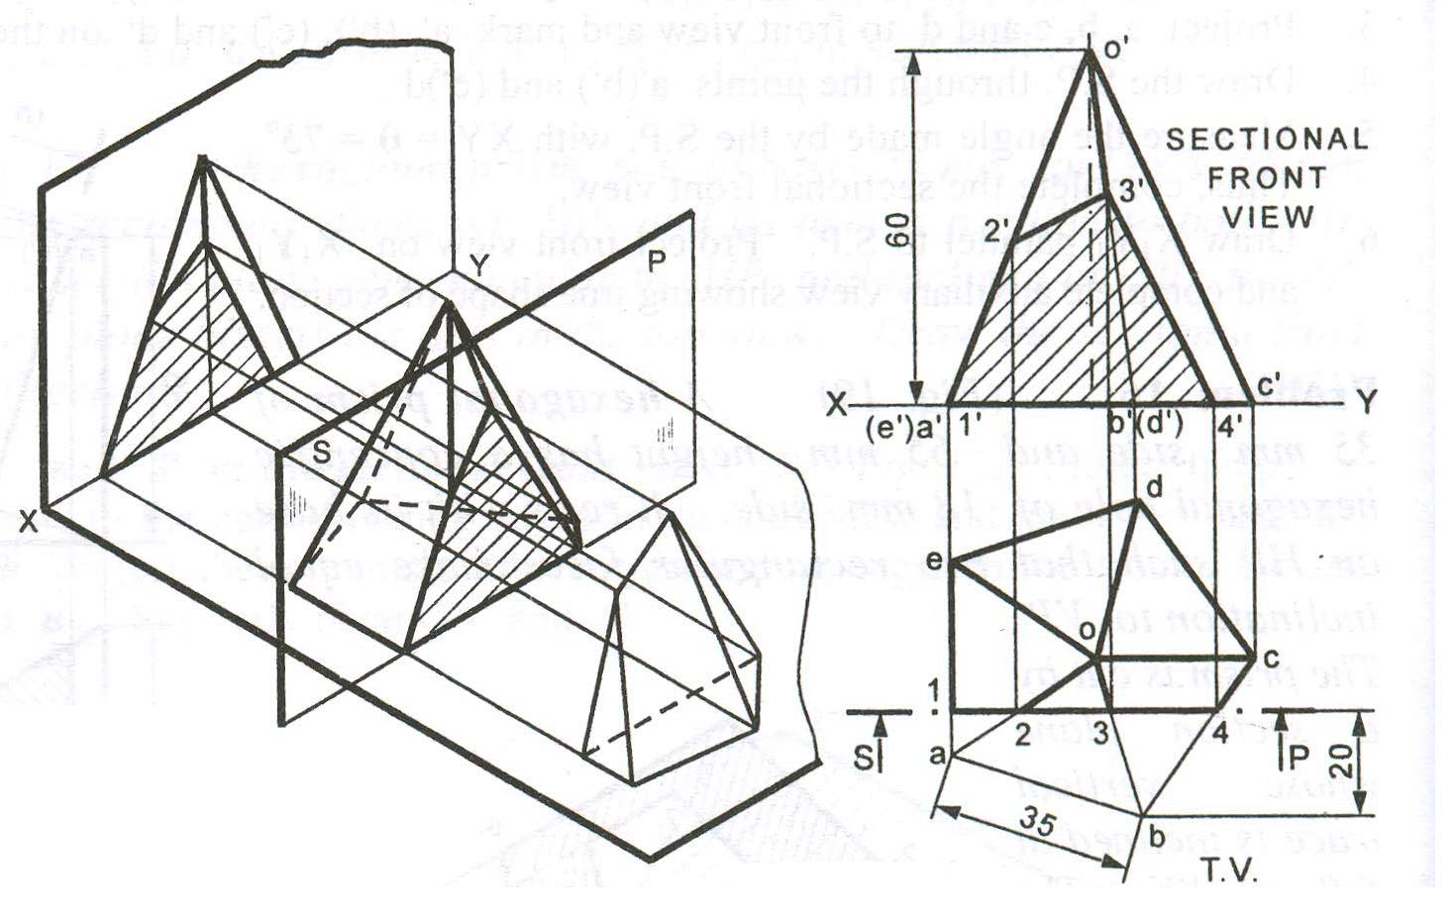
Pentagonal pyramid resting on HP with on of its edge perpendicular to VP
A vertical sectional place cuts the solid 20 mm away from the farthest corner of solid from XY reference line.
o’
3’
2’
1’
a’(e’)
b’(d’)
4’
c’
d
e
o
c
a
b

Slide 23
Perpendicular to V.P. and Parallel to H.P.
A cone of base 50 mm diameter and axis 65 mm long, lies on H.P. on one of its generators with its axis parallel to V.P. A horizontal sectional plane bisects the axis of the cone. Draw its top view and sectional front view.
O’
O’
60
f’
g’
d’
e’
b’
c’
a’
X
1’
2’, 8’
3’, 7’
4’, 6’
5’
15
Y
7
7₁
8
6₁
f
8₁
6
3’, 7’
1’
2’, 8’
d
4’, 6’
5’
c
O
1₁
a
1
5
5₁
O₁
b
2₁
e
Φ60
2
4
4₁
g
3
3₁
Assume cone is resting on HP
Tilt cone about its corner

Slide 24
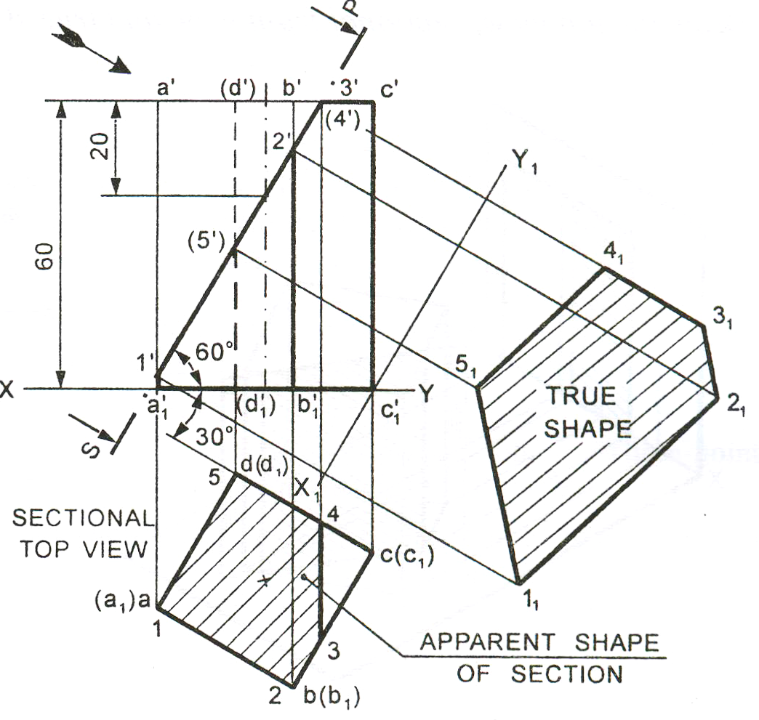
Perpendicular to V.P. and inclined to H.P.
A square prism, side of base 30 mm and axis 60 mm long, rests with its base on H.P. and one of its rectangular faces is inclined at 30º to VP. A section plane perpendicular to V.P. and inclined at 60º to H.P. cuts the axis of the prism at a point 20 mm from its top end. Draw the sectional top view and true shape of the section
a’
d’
b’
c’
20
d(s)
5
4
c(r)
a(p)
1
3
2
b(q)
Notes:
NOTE : Here , in FV , the cutting plane is intersecting both the edges bc as well as dc( observe). Hence, we have taken two points in TV(3 & 4)

Slide 25
A cone base 75 mm diameter and axis 80 mm long is resting on its base on H.P. It is cut by a section plane perpendicular to the V.P., inclined at 45º to the H.P. and cutting the axis at a point 35 mm from the apex.
Draw the front view, sectional top view, sectional side view and true shape of the section.
X₁
e₁
f₁
g₁
c₁
d₁
h₁
i₁
o’
o”
b₁
j₁
k₁
35
g”
g’
f”
h”
a₁
f’
e’
i”
l₁
h’
e”
i’
d’
d”
j”
c’
j’
k’
c”
k”
b’
b”
l”
a’
l’
a”
X
2 12
3 11
4 10
5 9
6 8
Y
7
10”
1
4”
5”
6”
7”
8”
9”
3”
2”
1”
12”
11”
4
3
5
2
c
d
6
b
e
o
f
1
a
g
7
h
12
l
j
i
8
k
11
9
Y₁
10

Slide 26
A square pyramid, base 40 mm side and axis 65 mm long, has its base on the HP and all the edges of the base equally inclined to the VP. It is cut by a section plane, perpendicular to the VP, inclined at 45º to the HP and bisecting the axis. Draw its sectional top view, sectional side view and true shape of the section.
2₁
3₁
X₁
o”
o’
4₁
3”
3’
1₁
4”
2”
2’
4’
1’
X
b’
d’
1”
Y
a’
45º
c’
c”
d
d”
a”
b”
4
a
1
o
c
3
2
b
Y₁
Notes:
Note the step for locating the points 2 and 4.
Alternatively, for locating the points 2 and 4 in the sectional TV, we can also take the help of SV.

Slide 27
A Hexagonal prism has a face on the H.P. and the axis parallel to the V.P. It is cut by a vertical section plane which makes an angle of 45 with XY and which cuts the axis at a point 20 mm from one of its ends along the central line. Draw its sectional front view and the true shape of the section. Side of base 25 mm long height 65mm.
b’
c’
a’
e’
d’
f’
6’
7’
f’
f’
a’
a’
65
1’
5’
b’
b’
e’
e’
2’
c’
Y
X
c’
d’
a’
b’
c’
d’
f’
e’
d’
4’
3’
b
b₁
b₁
1
3
2
a
c
7
a₁
a₁
c₁
c₁
25
Y₁
6
4
f₁
f₁
d₁
f
d
d₁
20
3₁’
2₁’
e
e₁
e₁
1₁’
5
4₁’
7₁’
X₁
5₁’
6₁’

Slide 28
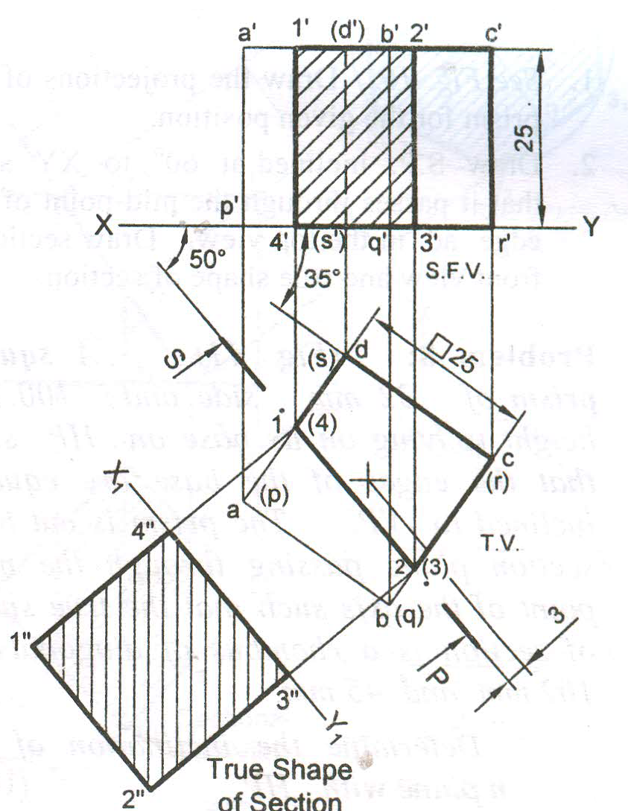
1. Square prism resting on HP with one of its edges making 35º to VP
2. Section plane perpendicular to HP cuts the solid 3 mm away from the axis of solid and is inclined at 50º to VP.
a’
1’
d’
b’
2’
c’
p’
s’
q’
r’
35º
4’
3’
50º
d(s)
1(4)
a(p)
c(r)
2(3)
b(q)
Notes:
For drawing a AVP at a dist of 3mm from the axis, first draw a 50 deg line passing through the TV of the axis, and then shift it 3mm parallely.
NOTE: In every question of this lab sheet, the true shape of the section should be drawn on that side of the sec. plane which contains the arrows.

Slide 29
A pentagonal pyramid , base 30mm side and axis 60 mm long is lying on one of its triangular faces on the HP with the axis parallel to the VP. A vertical section plane, whose HT bisects the top view of the axis and makes an angle of 30º with the reference line, cuts the pyramid removing its top part. Draw the top view, sectional front view and true shape of the section and development of the surface of the remaining portion of the pyramid.
o’
a’
6’
60
b’e’
1’
5’
2’
a’
b’e’
c’d’
o’
Y
X
c’d’
b₁
4’
3’
b
c
c₁
2
o₁
a₁
1
3
a
o
30
d₁
6
4
3₁’
2₁’
d
5
e
e₁
4₁’
1₁’
5₁’
6₁’

Slide 30
Comparison between section views when the section plane is parallel and inclined to one of the Reference Planes

Slide 31
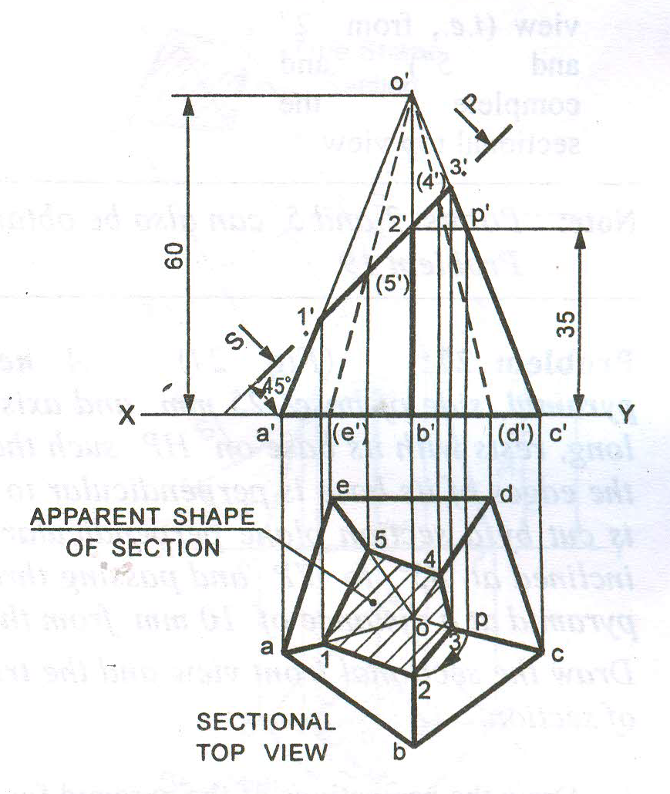
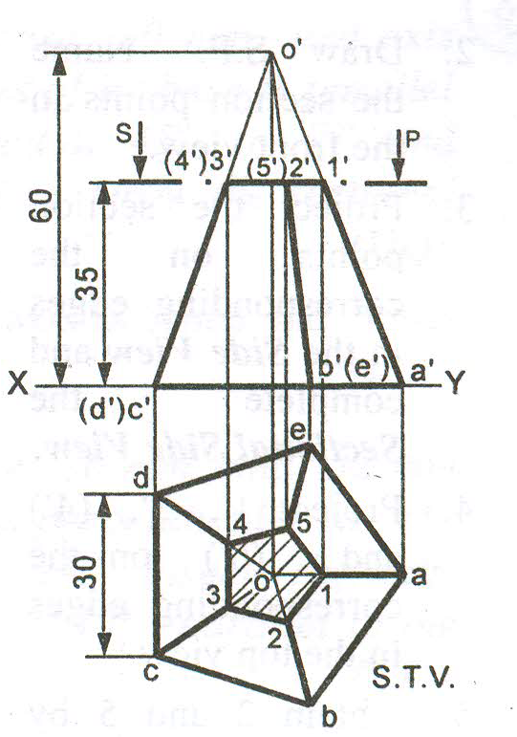
Horizontal sectional plane
Inclined sectional plane

Slide 32

Thank You for Patient Hearing

